Slide 1
CS585/DS503 Big Data Management
Introduction & Logistics
WPI, Mohamed Eltabakh

Slide 2
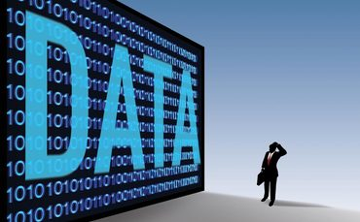
Theme of this Course
Large-Scale Data Management
Big Data Analytics
Data Science and Analytics
How to manage very large amounts of data and extract value and knowledge from them

Slide 3
Introduction to Big Data
What is Big Data?
What makes data, “Big” Data?

Slide 4



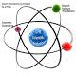




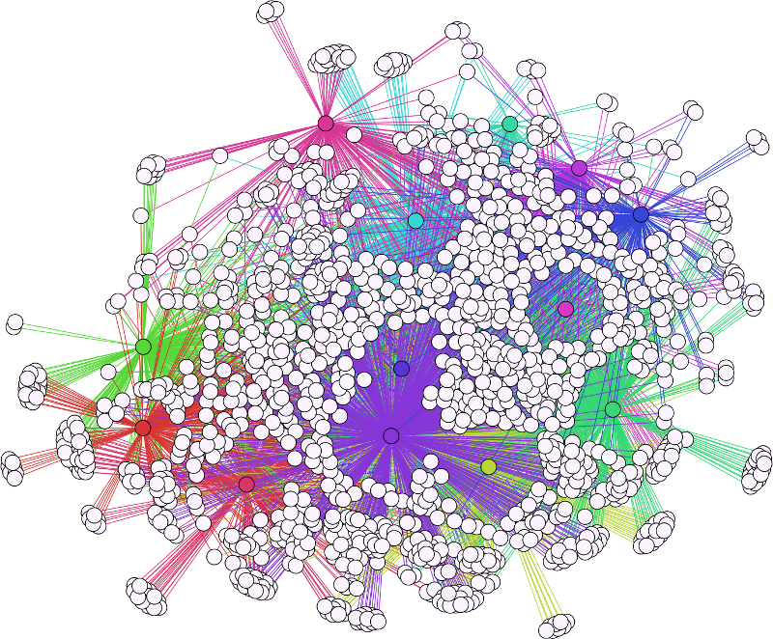


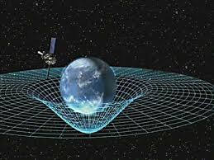
Data Management Applications
Big Spectrum
Banking
Physics
Streaming
Retail Sys
Biology
Social Media
Graph Data
Airlines
Spatio-
Temporal
Big
Data
Traditional
Scientific and
More advanced
Big Data

Slide 5
Big Data Definition
No single standard definition…
“Big Data” is data whose scale, diversity, and complexity require new architecture, techniques, algorithms, and analytics to manage it and extract value and hidden knowledge from it…

Slide 6
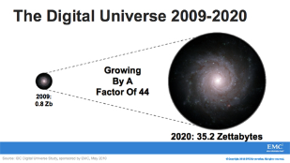
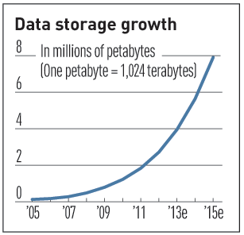

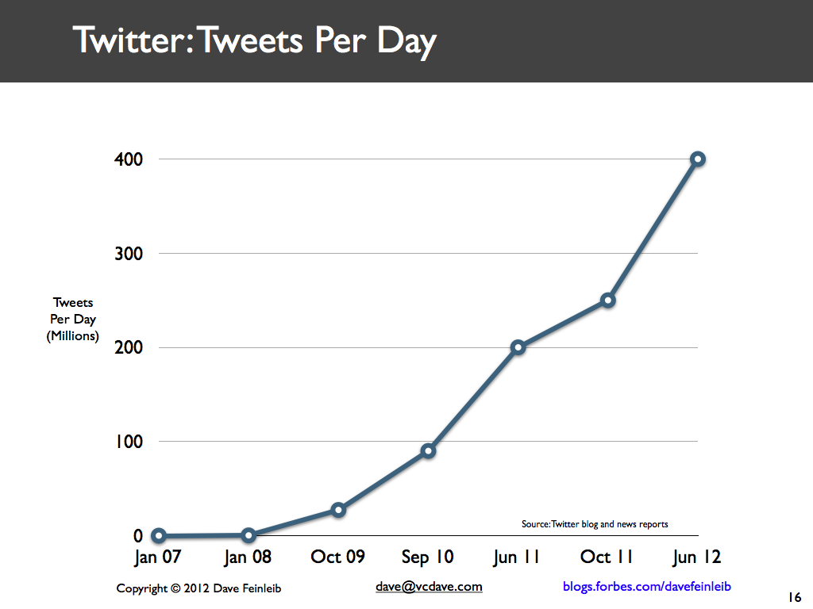
Characteristics of Big Data: 1-Scale (Volume)
Data Volume
44x increase from 2009 2020
From 0.8 zettabytes to 35zb
Data volume is increasing exponentially
Exponential increase in collected/generated data

Slide 7
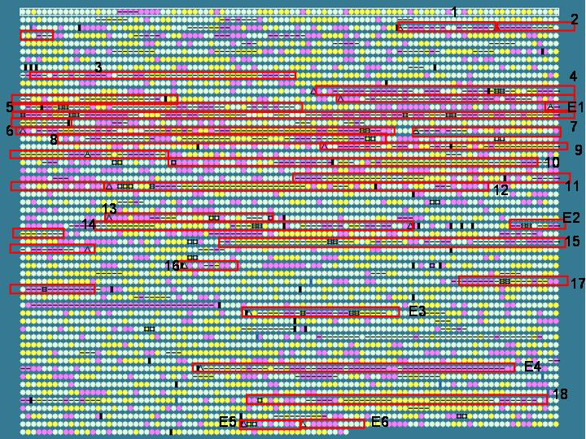

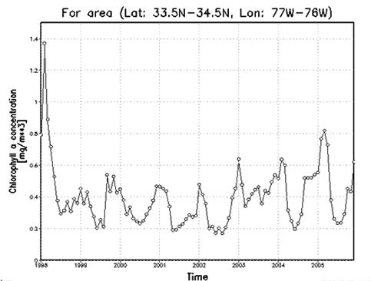

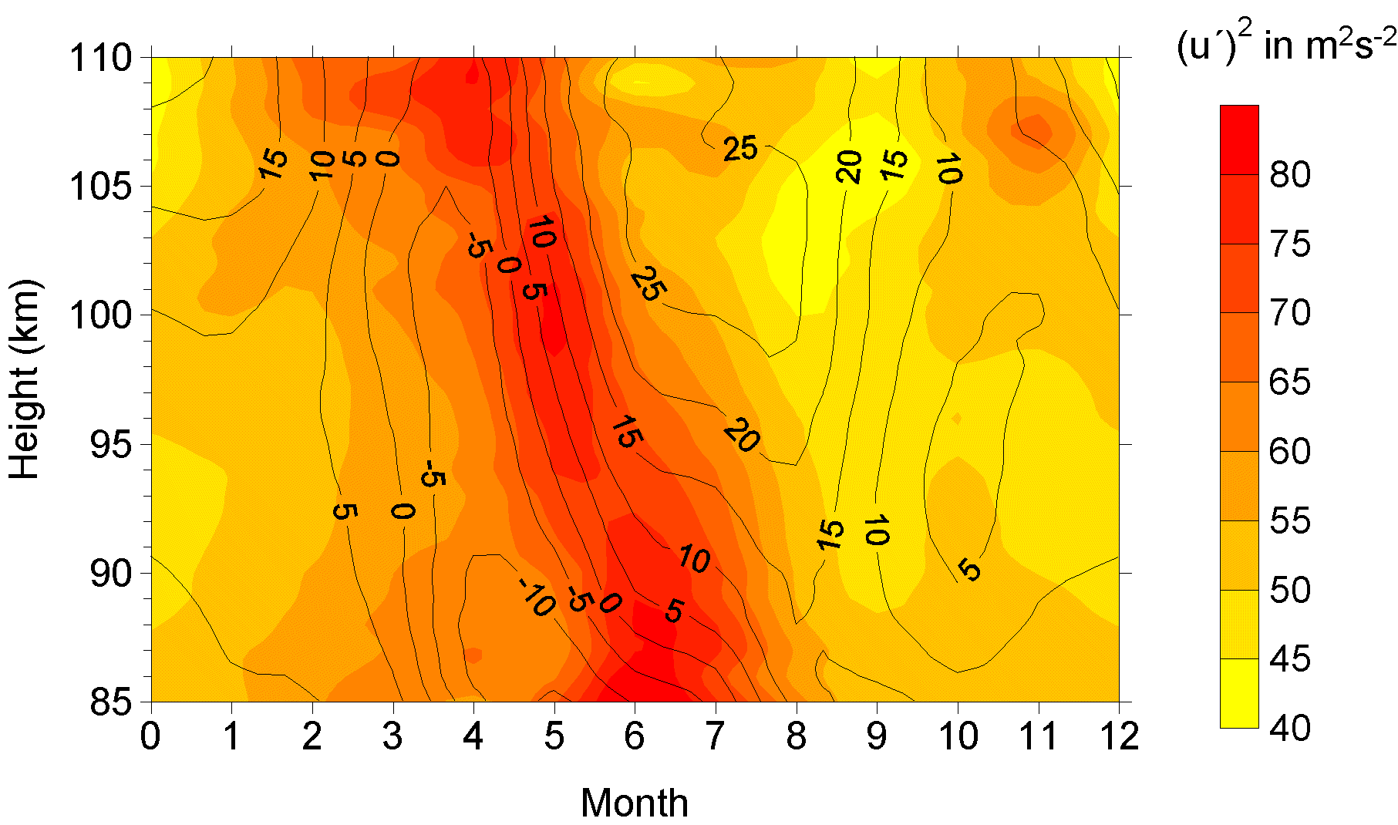

Characteristics of Big Data: 2-Complexity (Varity)
Various formats, types, and structures
Text, numerical, images, audio, video, sequences, time series, social media data, multi-dim arrays, etc…
Static data vs. streaming data
A single application can be generating/collecting many types of data
To extract knowledge➔ all these types of data need to linked together

Slide 8

Characteristics of Big Data: 3-Speed (Velocity)
Data is begin generated fast and need to be processed fast
Online Data Analytics
Late decisions ➔ missing opportunities
Examples
E-Promotions: Based on your current location, your purchase history, what you like ➔ send promotions right now for store next to you
Healthcare monitoring: sensors monitoring your activities and body ➔ any abnormal measurements require immediate reaction

Slide 9
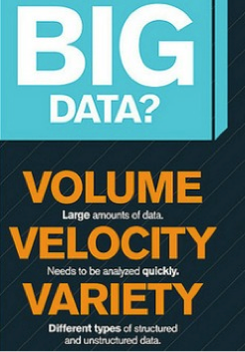

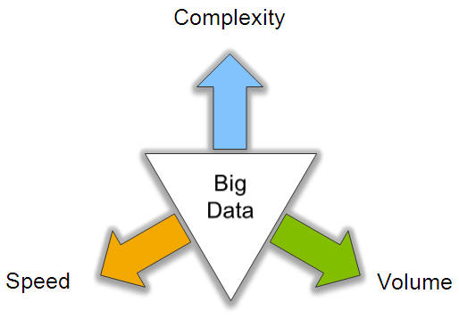
Big Data: 3V’s

Slide 10
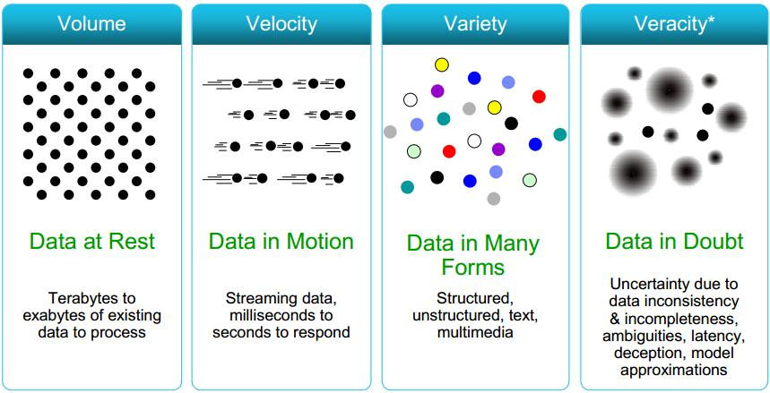
Some Make it 4V’s

Slide 11
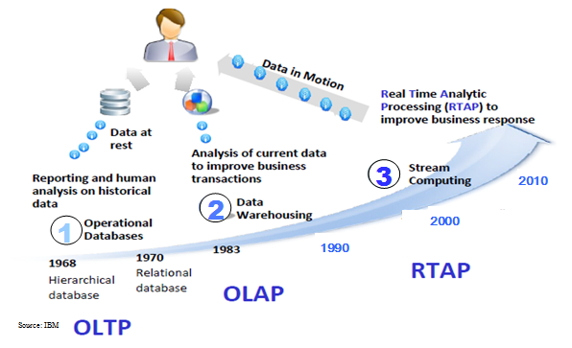
Harnessing Big Data
OLTP: Online Transaction Processing (DBMSs)
OLAP: Online Analytical Processing (Data Warehousing)
RTAP: Real-Time Analytics Processing (Big Data Architecture & technology)

Slide 12
Data Explosion

Slide 13

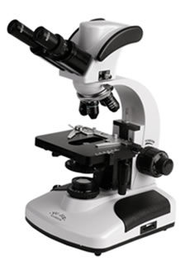

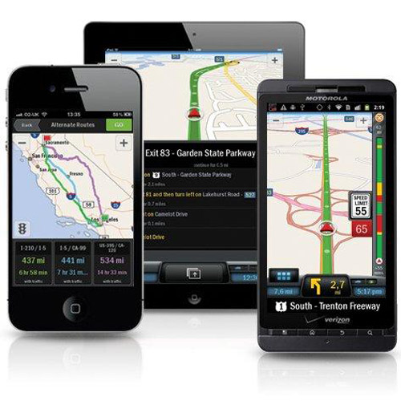

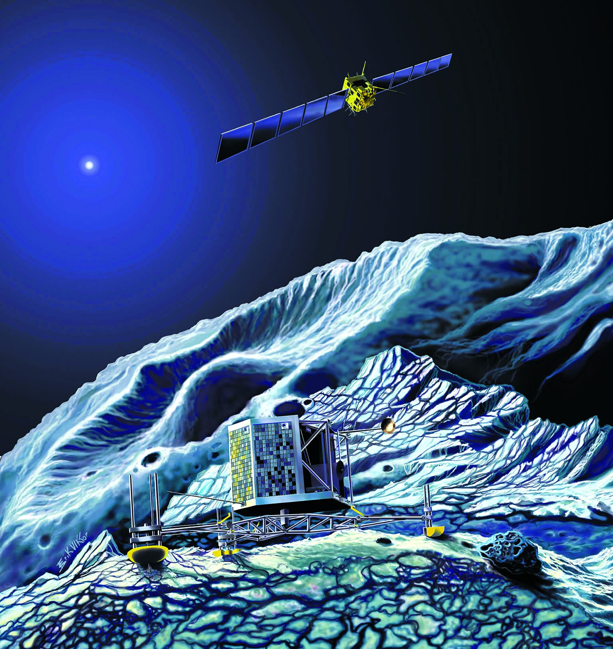
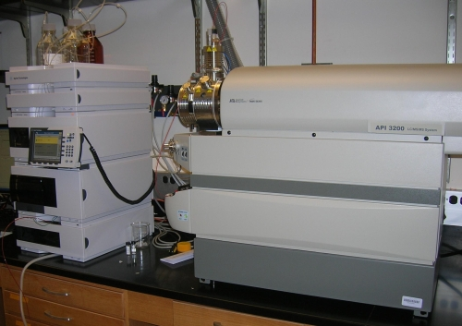
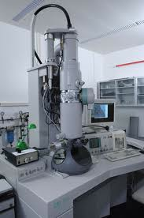
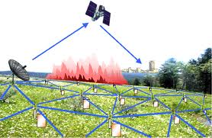

Who’s Generating Big Data
Mobile devices
(tracking all objects all the time)
Social media and networks
(all of us are generating data)
Scientific instruments
(collecting all sorts of data)
Sensor technology and networks
(measuring all kinds of data)
The progress and innovation is no longer hindered by the ability to collect data
But, by the ability to manage, analyze, summarize, visualize, and discover knowledge from the collected data in a timely manner and in a scalable fashion

Slide 14
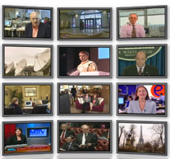



The Model Has Changed…
The Model of Generating/Consuming Data has Changed
Old Model: Few companies are generating data, all others are consuming data
New Model: all of us are generating data, and all of us are consuming data

Slide 15
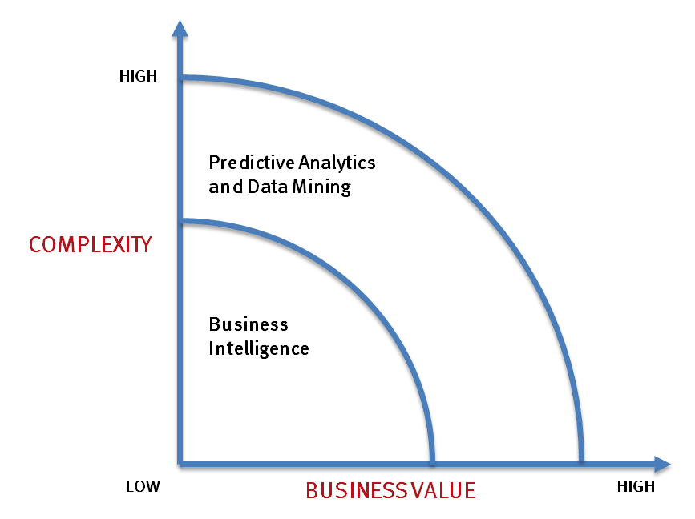
What’s driving Big Data
- Optimizations and predictive analytics
- Complex statistical analysis
- All types of data, and many sources
- Very large datasets
- More of a real-time
- Ad-hoc querying and reporting
- Data mining techniques
- Structured data, typical sources
- Small to mid-size datasets

Slide 16
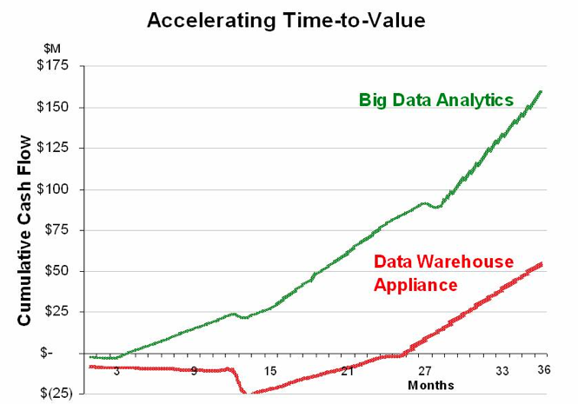
Value of Big Data Analytics
Big data is more real-time in nature than traditional DW applications
Traditional DW architectures (e.g. Exadata, Teradata) are not well-suited for big data apps
Shared nothing, massively parallel processing, scale out architectures are well-suited for big data apps

Slide 17
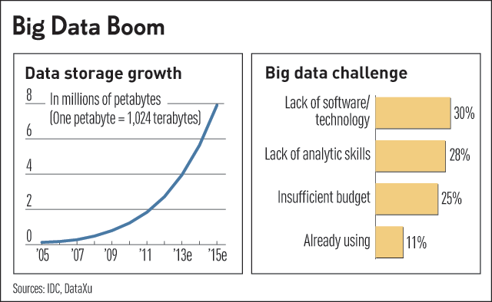
Challenges in Handling Big Data
The Bottleneck is in technology
New architecture, algorithms, techniques are needed
Also in technical skills
Experts in using the new technology and dealing with big data

Slide 18
What Technology Do We Have
For Big Data ??

Slide 19
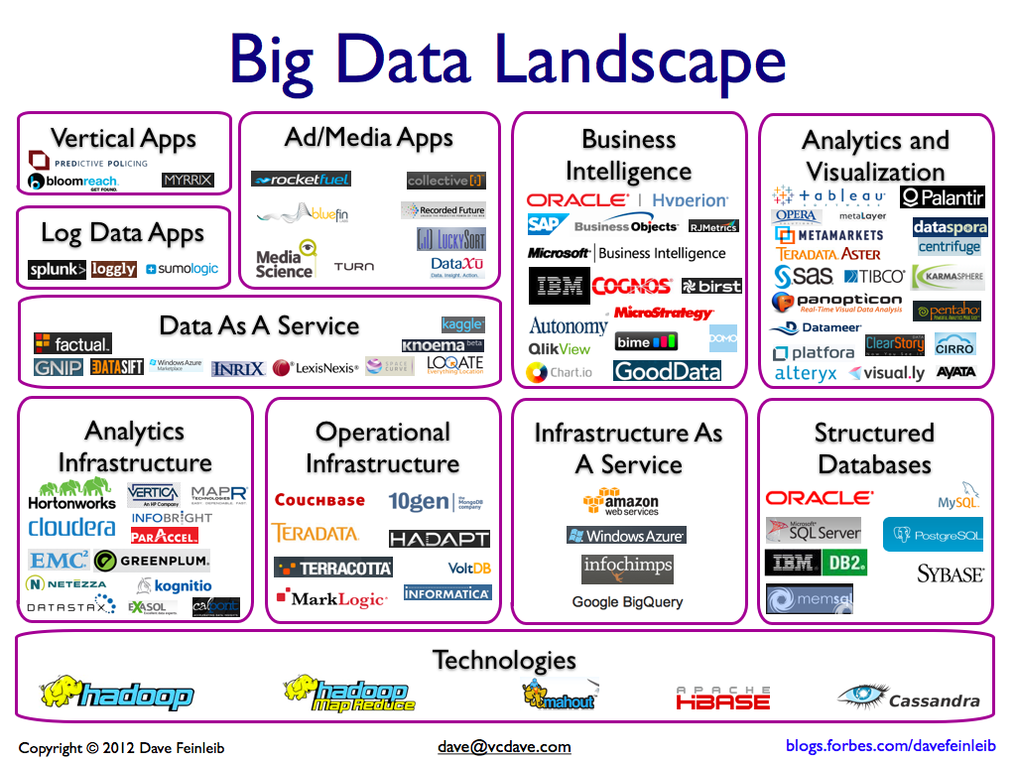

Slide 20
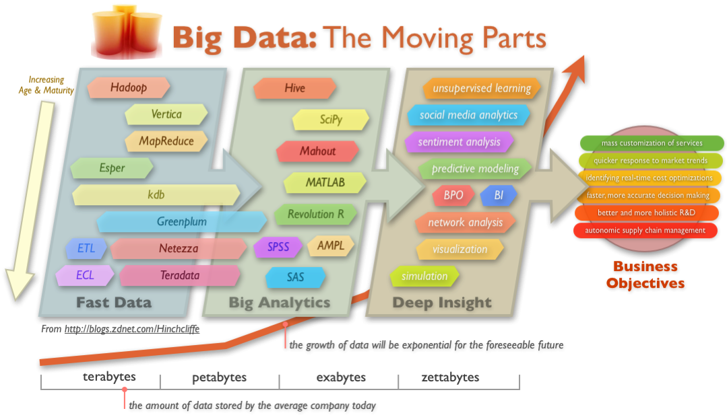
Big Data Technology

Slide 21
What You Will Learn MapReduce/Hadoop
Learn the platform (how it is designed and works)
How big data are managed in a scalable, efficient way
Learn writing Hadoop jobs in different languages
Programming Languages: Java, C, Python
High-Level Languages: Apache Pig, Hive
Learn advanced analytics tools on top of Hadoop
RHadoop: Statistical tools for managing big data
Mahout: Data mining and machine learning tools over big data
Learn state-of-art technology from recent research papers
Optimizations, indexing techniques, and other extensions to Hadoop

Slide 22
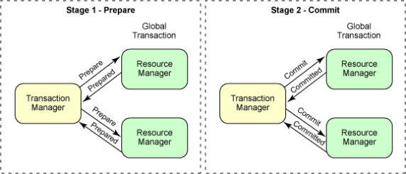
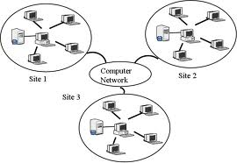
What You Will Learn Distributed DBMSs
Differences from traditional DBMSs
Data and Query Models
Several operators and transaction management

Slide 23

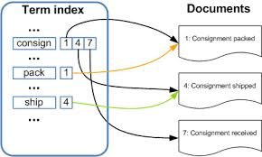
What You Will Learn NoSQL DBs
MongoDB and Document DBs
Lucene Index

Slide 24

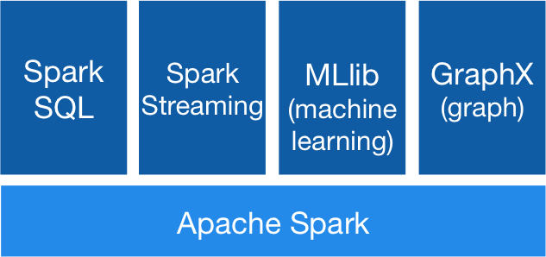
What You Will Learn Spark
In-Memory Data Processing

Slide 25

What You Will Learn State-of-art in Research
Covering many research papers
Presentations/discussion/quizzes

Slide 26
Course Logistics

Slide 27
Course Logistics
Web Page: http://web.cs.wpi.edu/~cs585/s17/
Electronic WPI system: blackboard.wpi.edu
Lectures
Thursdays: (6:00 - 8:50pm)
Divided into 2 sub-lectures 80, 80, & 10 mins break

Slide 28
Textbook & Reading List
No specific textbook
Big Data is a relatively new topic (so no fixed syllabus)
Reading List
We will cover the state-of-art technology from research papers in big conferences
Many Hadoop-related papers are available on the course website
Related books:
Check the course website

Slide 29
Requirements & Grading
Seminar-Type Course
Students will read research papers and present them (Reading List)
Hands-on Course
Several coding projects covering the entire semester
Assignments
Coding Projects
Presentations
4 Quizzes
Final Exam
Done in teams of two

Slide 30
Late Submission Policy
For Projects
One-day late → 10% off the max grade
Two-day late → 20% off the max grade
Beyond that, no late submission is accepted
Submissions:
Submitted via blackboard system by the due date

Slide 31
More about Projects
A virtual machine is created including the needed platform for the projects
Ubuntu OS
Hadoop platform
Apache Pig/ Hive
Mahout library (Version 0.7)
Rhadoop
MongoDB
Need Virtual Box (Vbox) [free]

Slide 32
Next Step from You…
Form teams of two
Visit the course website
Plan ahead:
Decide what/when you want to present??
Use Blackboard “Discussion” forum for posts or for searching for teammates

Slide 33
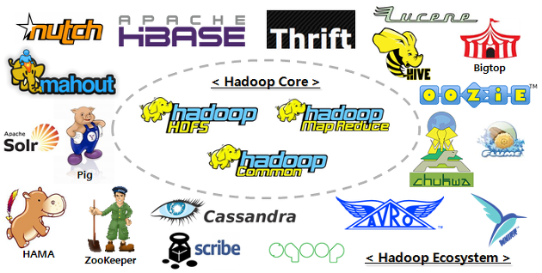

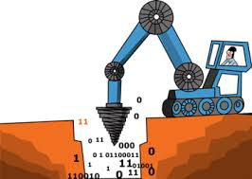

Summary of What You Will Learn
+
+
NoSQL: NotOnly SQL
Distributed DBs
MapReduce & Hadoop
+
+
Big Data Mining & Analytics
Presenting & Reading Research Papers

Slide 34
Prerequisites
Good knowledge about database systems
CS4432 (DB II) or CS542
Programming skills
Java, Python, Scala

